Slide 1
Kudo Icons
Starter – Actions (blue)

Slide 2
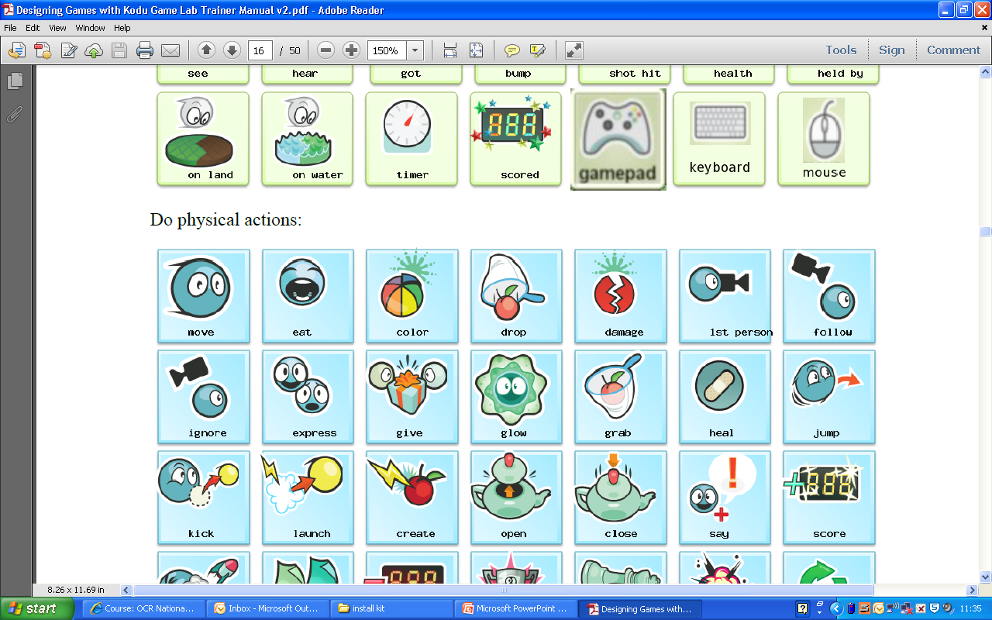
Guess the icon

Slide 3
Guess the icon

Slide 4
Guess the icon

Slide 5
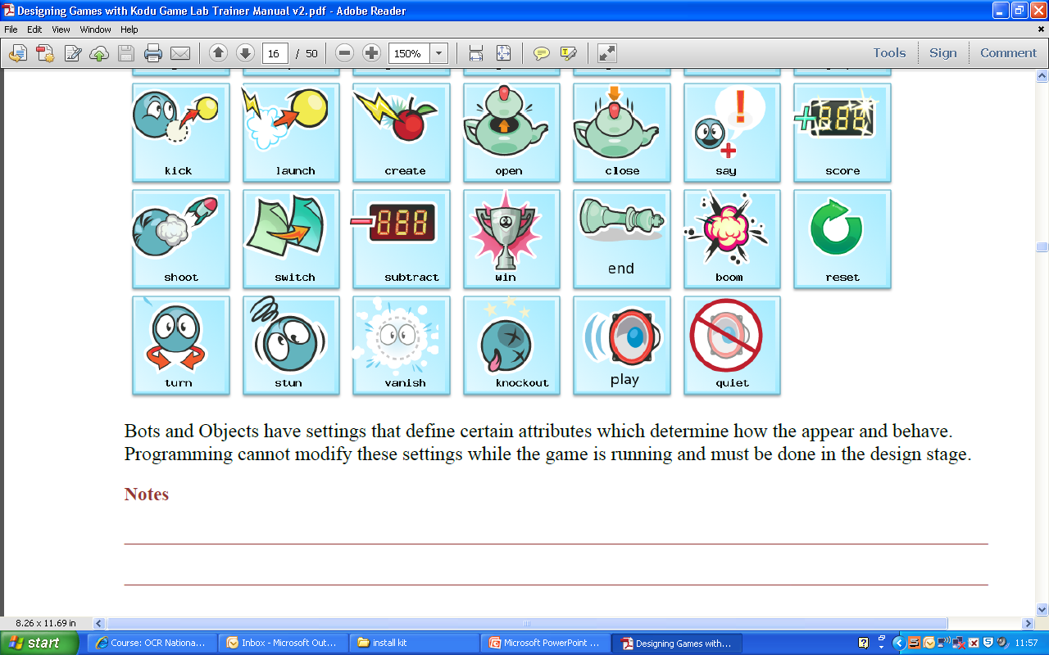
Guess the icon

Slide 6
Guess the icon

Slide 7
Guess the icon

Slide 8
Guess the icon

